Slide 1
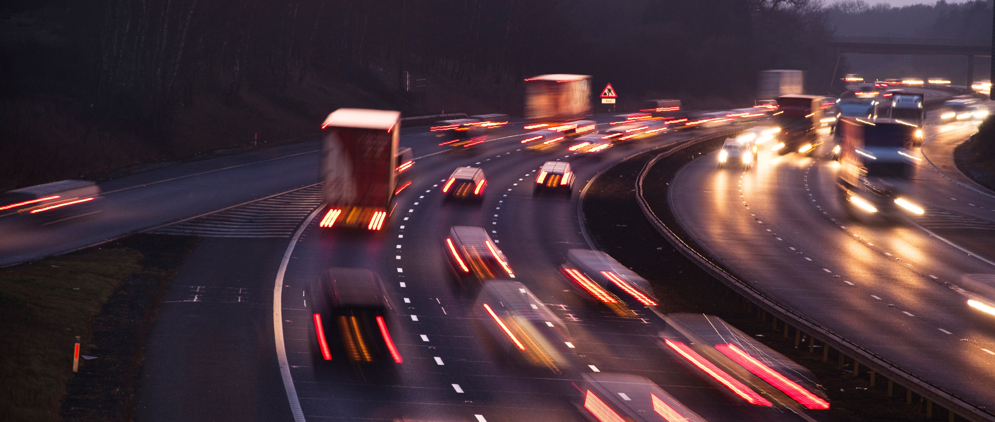
Matthew Lugg OBE UK HEAD OF PROFESSION FOR LOCAL GOVERNMENT
PACTS conference: 21.10.21
Zero carbon and zero road deaths
Does less traffic mean safer traffic?
THE UK’S TRANSPORT
DECARBONISATION PLAN

Slide 2
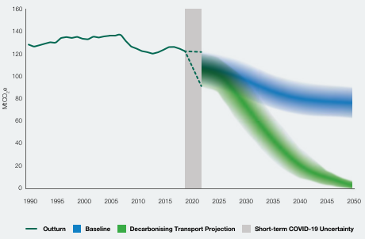
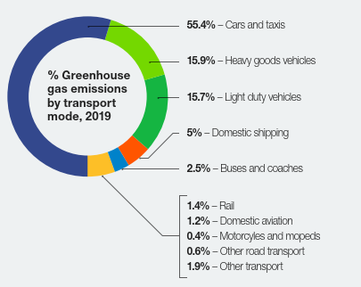
CARBON EMISSIONS FROM TRANSPORT ARE LITTLE CHANGED SINCE 1990

Slide 3
TDP SEES TRANSPORT RAPIDLY DECARBONISING BETWEEN NOW AND 2050

Slide 4
THIS IS DELIVERED BY SIX KEY THEMES
Notes:
Air quality £9bn 2020-2050
Health – phycial inactivity costs the NHS £1bn with indirect costs of £8.2bn
Jobs – 72000 jobs worth up to £9.7bn
Priorities
Accelerating modal shift to public and actige transport
Decarbni road vehciles and freight.
Place based solutions – Every place in the UK will have its own net zero emission transport network before 2050, serving the unique needs of its communities. Sustainability will be at the heart of levelling-up.
Radical change will come from empowering and supporting local leaders, harnessing the strengths and expertise of local authorities, mayoral combined authorities, Sub-National Transport Bodies, the devolved administrations and local interest groups, all of whom have a crucial part to play.
Local authorities will have the power and ambition to make bold decisions to influence how people travel and take local action to make the best use of space to enable active travel, transform local public transport operations, ensure recharging and refuelling infrastructure meets local needs, consider appropriate parking or congestion management policies, initiate demand responsive travel, as well as promoting and supporting positive behaviour change through communications and education.
We will better coordinate local transport funding by engaging local areas about their investment priorities in the round, achieving key objectives such as decarbonisation through better strategic planning and more joined up infrastructure projects.
UK aviation and shipping will achieve net zero emissions by 2050. Ahead of that, our domestic lead will act as a showcase to the world and bolster our call to action internationally,

Slide 5
THIS IS DELIVERED BY SIX KEY THEMES
Notes:
Air quality £9bn 2020-2050
Health – phycial inactivity costs the NHS £1bn with indirect costs of £8.2bn
Jobs – 72000 jobs worth up to £9.7bn
Priorities
Accelerating modal shift to public and actige transport
Decarbni road vehciles and freight.
Place based solutions – Every place in the UK will have its own net zero emission transport network before 2050, serving the unique needs of its communities. Sustainability will be at the heart of levelling-up.
Radical change will come from empowering and supporting local leaders, harnessing the strengths and expertise of local authorities, mayoral combined authorities, Sub-National Transport Bodies, the devolved administrations and local interest groups, all of whom have a crucial part to play.
Local authorities will have the power and ambition to make bold decisions to influence how people travel and take local action to make the best use of space to enable active travel, transform local public transport operations, ensure recharging and refuelling infrastructure meets local needs, consider appropriate parking or congestion management policies, initiate demand responsive travel, as well as promoting and supporting positive behaviour change through communications and education.
We will better coordinate local transport funding by engaging local areas about their investment priorities in the round, achieving key objectives such as decarbonisation through better strategic planning and more joined up infrastructure projects.
UK aviation and shipping will achieve net zero emissions by 2050. Ahead of that, our domestic lead will act as a showcase to the world and bolster our call to action internationally,

Slide 6
DECARBONISING CARS, VANS, BUSES AND TRUCKS
Consultation on a zero emission vehicle mandate
2040 consultation on phase out of sale of new diesel HGVs >26t
2040 all new coaches entering the fleet to be zero emission?
2040 – all diesel trains removed from the network (proposed)
2030 Phase of sale of new petrol & diesel cars and vans
2035 Phase out of sale of new hybrid cars and vans
2035 consultation on phase out of petrol motorbikes & scooters
2035 end sale of new non-zero emission HGVs <26t
2050 – all transport zero emission

Slide 7
THIS IS DELIVERED BY SIX KEY THEMES

Slide 8
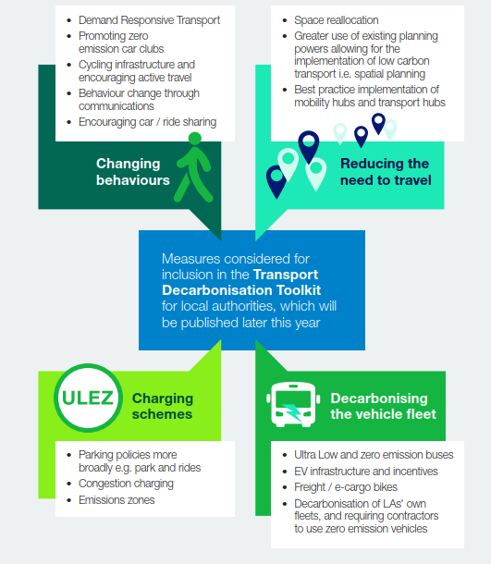
LOCAL AUTHORITIES AT THE HEART OF DELIVERY
“Local transport infrastructure will be reformed to drive and deliver decarbonisation at a local level”
Local Transport Plans will need to set out how local areas will deliver ambitious, quantifiable carbon reduction in transport. In line with carbon budgets and net zero
Funding will be conditional on demonstrating emission reductions through the LTP.
Guidance toolkit to be published later this year
Update business case and appraisals to align decisions with decarbonisation
Sustainable transport as part of new masterplanning

Slide 9
DECARBONISING TRANSPORT IS MUCH MORE THAN ELECTRIFIYING THE FLEET
Travel choices driven by:
Habit
Convenience
Speed
Reliability
Flexibility
Family friendly
Door to door
Availability / ease of access
Comfort
Life stage.
11-18yos have little control over mode
Young adults – more public transport
Parents of young kids – drive
Older people
Urban-rural
Environmental factors a ‘bonus’ only
Expectation that travel patterns and mode will return to pre-lockdown norms
Cars are seen as super convenient. Focus on price, convenience, once alternatives exist.
Source: Committee on Climate Change analysis, slide 25 in ‘The role of energy in meeting the UK’s net zero greenhouse gas targets’; https://carbonliteracy.com/wp-content/uploads/2020/01/CCC-Energy-role-in-meeting-net-zero-targets.pdf
Decarbonising transport: deliberative research - GOV.UK (www.gov.uk)

Slide 10
THIS IS DELIVERED BY SIX KEY THEMES

Slide 11
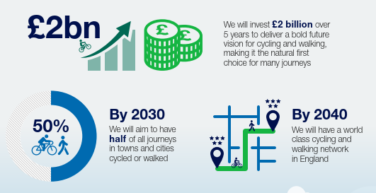
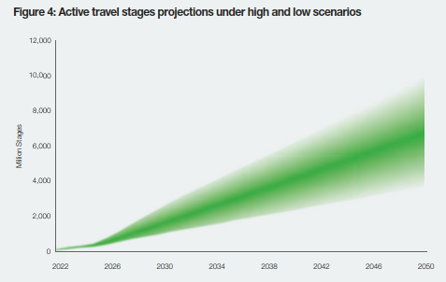
INCREASING CYCLING AND WALKING
Gear Change programme – target of half of all journeys in towns and cities to be by walking or cycling by 2030
A zero emission transport city
Low Traffic Neighbourhoods
Stronger encouragement for LA’s to apply LTN120 – possibly a mandatory requirement for DfT funding for cycling.

Slide 12
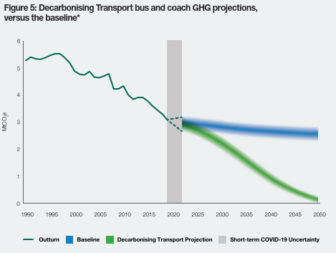
BUS BACK BETTER
National Bus Strategy
Bus Service Improvement Plans due by October 2021
Focus on more than just green fleets
Increase in BSOG green incentive for zero emission buses to 22p / km

Slide 13
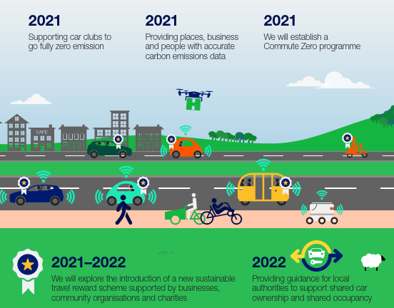
OTHER AREAS
Notes:
Travel reward scheme that uses peer driven motivation and encourages individuals to switch to or keep using suswtainable modes of travel. Online by 2024

Slide 14
In Summary the TDP
Is to be welcomed
Although it will be challenging to deliver
Does it go far enough?
Will it be adequately funded?
How will the behaviour changes needed to make it happen come about ?
And finally The PACTS REWP will continue to carefully monitor the delivery of the TDP to ensure road safety remains paramount in any adaptation of the highway infrastructure needed to support the TDP

