Slide 1
The Role of The GP in Giving Advice on Fitness to Drive
Dr Carol Hawley
Warwick Medical School
University of Warwick

Slide 2
Older Drivers: UK National Travel Survey 2010 & DfT Road Safety Statistics 2011
78% of 70+ year old men hold a full driving licence
41% of women (57% overall 70+ year olds)
Number of car drivers over 70 yrs old involved in a reported accident = 10,465 (5% of total 212,685)
46% of 70+ drivers had an injury (4,782)
6506 car drivers killed or seriously injured
70 – 79 age group: 6% of total (386)
80+ age group: 5% of total (320)
Older drivers not the biggest risk group on the roads
Number of accidents due to medical condition: unknown

Slide 3
Licensing Practices for Older Drivers
US – varies between states
Australia – varies between territories
E.g. Victoria: no regular testing
But New South Wales: annual medical report from age 80. Annual road test from 85yrs.
Western Australia: Medical report ages 75, 78, 80 then annually. Annual road test from 85 yrs.
Tasmania: from 7/10/11 ended compulsory annual driving assessments.
UK – 3 year renewable licence through self-declaration from age 70.

Slide 4
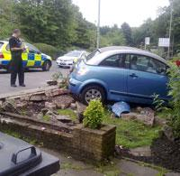
Reasons for Variation
No evidence that drivers become less safe at a particular age.
Older driver crash involvement is related to high risk sub-groups (Hu et al, 1998)
Frailty rather than general decline in driving skills is linked to accidents (Evans, 1991; Maycock, 1997)
“An elderly driver in her 70s landed her car in a front garden of after losing control of her Citroen C3. The garden's roses faired better than its wall which was completely demolished. No one was injured in the incident.” News item 2011

Slide 5
Fitness to drive (FTD), who decides?
UK: Onus on driver to decide whether to restrict or cease driving.
Many older drivers self-regulate their driving.
DirectGov website (Oct. 2011) clearly advises drivers to ask a health professional for advice on FTD.

Slide 6
DirectGov advice to older drivers:
1. ‘It may be time to give up driving if you have a medical condition that may affect your ability to drive safely – ask your GP for advice.’
2. ‘If you are on prescribed medication, ask your doctor if it could affect your driving.’
3. ‘If you think your vision is changing, speak to your optician, GP or specialist.’
4. ‘If you are worried about your fitness to drive, talk to your GP or health professional.’

Slide 7
6 Main groups of unfit drivers
Can’t see correctly (visual impairment)
Can’t think correctly (cognitive impairment e.g. dementia)
Can’t physically operate a vehicle (physical disability, frail elderly)
Risk of sudden incapacity (seizures, hypoglycaemia, cardiac arrhythmias)
Mental incapacity (psychiatric disorders)
Impaired by alcohol or drugs or medication

Slide 8
Role of Medical Practitioners
DVLA At A Glance Guide for Medical Practitioners (August 2011) provides GMC advice:
The driver is legally responsible for informing DVLA about any medical condition which may affect safe driving.
If the patient has such a condition you should explain to the patient that the condition may affect their ability to drive. If the patient is incapable of understanding this advice, e.g. because of dementia, you should inform DVLA immediately.

Slide 9
If patients do not take advice and stop driving:
‘If a patient continues to drive when they may not be fit to do so, you should make every reasonable effort to persuade them to stop.’
‘If you do not manage to persuade the patient to stop driving, or you discover that they are continuing to drive against your advice, you should contact the DVLA immediately and disclose any relevant information, in confidence, to the medical adviser.’

Slide 10
Sounds straightforward, but...
Fewer notifications to DVLA than would be expected from prevalence of medical conditions.
Study commissioned by Department for Transport to investigate the knowledge and attitudes of health professionals to giving advice on fitness to drive to patients
Hawley (2010)

Slide 11
Health Professionals and Advice on Fitness to Drive:
Research Questions
What do they know?
What do they think?
What do they say they do?
What do they do in practice?
What do patients think?
How can current practice be improved?

Slide 12
The Study (n =1923) (1565 HCPs, 358 patients)
Survey of all UK medical schools
Survey of final year medical students
National survey of knowledge/attitudes – all HCP groups
Exam style scenarios to test knowledge
Simulated consultations to test behaviour
Patient interviews
Diabetic (Type II) patient survey
In-depth case studies
Focus groups
GP survey
Structured workshops to devise strategies for change

Slide 13
Medical Education
All 32 UK Medical Schools surveyed
Unusual to find medical aspects of FTD on a syllabus
Rarely taught in relation to specific conditions
12 schools (38%) could be an exam question
Survey: 109 final year medical students
Few recall specific training, role of placements
Most know where to find information, but not when it is needed

Slide 14
What HCPs Say (National Survey n=630)
89% think that giving advice to patients on fitness to drive is important
91% think that HCPs have a duty of care to give driving advice to patients
70% think there is a need for clearer guidelines on FTD
60% say their knowledge of Medical Aspects of FTD is fairly poor
82% think HCPs need more training on FTD

Slide 15
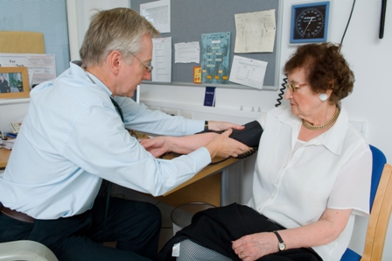
GPs are in the front line
Acknowledge it is probably their responsibility
Other HCPs and other agencies expect GPs to advise patients on FTD as the HCP who knows patient best

Slide 16
National Survey: agreement with key statements by professional group

Slide 17
GPs: DVLA guidelines consulted in last 2 years: Top 10 medical conditions

Slide 18
GPs: How many of your patients do you advise on FTD?

Slide 19
Exam-style Scenarios
413 health professionals (199 GPs, 214 other HCPs)
Scored a total of 1554 scenarios (3 or 4 each)
4 medical conditions: older/younger ; male/female in which a patient was either: fit to drive, unfit to drive or borderline.
Unfit Stroke: A 40-year-old male who suffered a minor stroke causing a right hemiparesis one month previously presents to you for check-up. You confirm that he has made a full, uncomplicated recovery with no residual neurological deficit. He asks would it be OK to return to work as a lorry driver.
Is he: fit/unfit/borderline

Slide 21
Scenario Test Results
Knowledge of medical standards was poor
7% (31/413) HCPs scored all their vignettes correctly.
Most correctly identified the ‘fit’ patient.
Bias towards rating patient as fit to drive.
Most accurate for epileptic patients.
Drs more accurate than other HCPs.

Slide 22
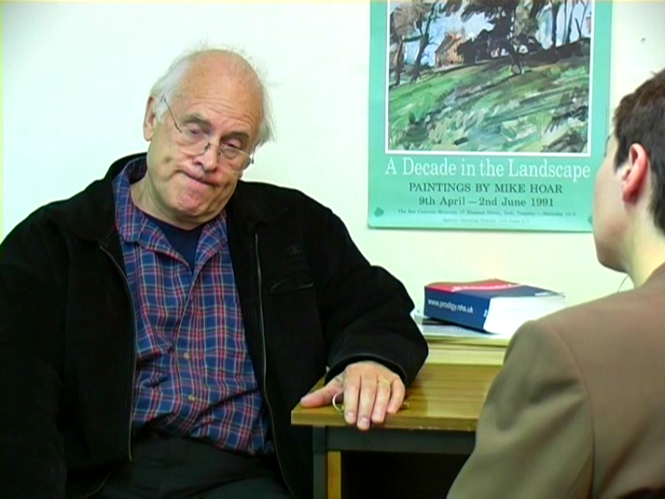

Slide 23
Simulated Consultation Exercise
(Attitudes and Behaviour)
3 medical conditions
  Transient Ischemic Attack
  Diabetes and visual impairment
  Depression with alcohol abuse and over-dependence on diazepam
  Male/Female, age 40 or 70
  Real Clinician: Primary/Secondary Care setting
  Plenty of driving clues....
  200 scenarios shown in pairs to 101 HCPs (50 GPs, 50 other HCPs)
  . “Lifestyle Advice Study”.
  Then interviewed and asked for main concerns, with 9 further prompts.
  10th prompt = “research shows that there are 5 key areas that patients often ask about: diet, work or hobbies, home, sex, driving…”.

Slide 24
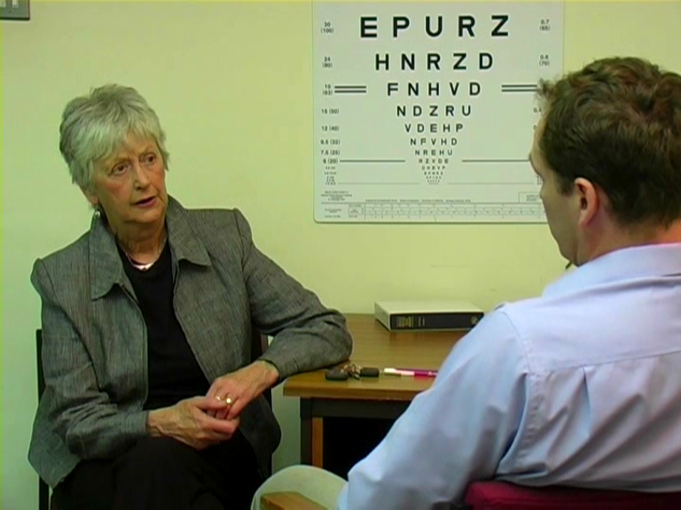

Slide 25
How would you advise this patient on their lifestyle?
Three quarters of HCPs did not raise fitness to drive unprompted
On average 12 minutes for respondent to mention driving as a concern (range = 1 to 28 minutes)
GPs less likely to raise FTD unprompted than Specialists.
No difference in unprompted advice to older versus younger patients – equally poor!
One Third of HCPs did not raise driving as an issue after 10 prompts.
Only 20% of interviewees volunteered specific driving advice

Slide 26
Simulated Consultation (200 vignettes, 101 HCPs): Driving as main ‘lifestyle’ concern

Slide 27
Medical condition and unprompted driving advice

Slide 28
How do you broach the topic with patients? (GPs)
We don’t
“… I suspect we probably don’t unless people actually say ‘Can I drive?’ ….” (F, urban).
Financial incentive
“You talk to them about alternatives like bus passes and point out how expensive it is to tax and insure a car and just how many taxi rides you could get from a tank full of petrol. (M, urban).
Scare tactics
I challenge them, ‘well what would happen if you had an accident and killed somebody or injured a child on a bike’. (M, urban).

Slide 29
How easy is it to keep up to date with DVLA medical rules?
“Well I just wait until I get sent a new book, I presume that they will send up one.” GP (F, rural)
“My source has hitherto been the DVLA guidelines which used to exist in hard form, I still have an outdated version of that. The current available up to date information they tell me is available on the internet or whatever it might be. That to me is a completely useless resource because I don’t have time to access it in consultations.” GP (M, suburban)
“It’s the click of a button; there is a link on my computer. I go straight into the guidelines.” GP (M).

Slide 30
Barriers to giving advice (GPs)
“It is difficult as it is often a confrontational issue.” (rural)
“In health terms very often you run the risk of seriously impairing the quality of somebody’s life. …You have stopped somebody driving and you could see them six months later with depression because you have totally destroyed their life.” (suburban).
”Time constraints, we have 10 minute consultations and fitness to drive is not really a health benefit for the patient. I mean it is if they crash and kill themselves or somebody else…. Things that they are doing to their body are the things that we have to address first of all.” (urban)

Slide 31
Whose role is it to advise?
“The GP is the best person because he is the one most likely to see the whole thing …” (M,GP, urban)
“…for some people you’re about to take away their job, their life ... It’s a breaking bad news barrier but you have got to do it and it’s your job. (M, GP)
“it isn’t actually by itself a medical issue, it’s a social issue and there is a tendency in my view in society to hand the social issues over to the medical profession.” (M, GP)

Slide 32
Have you ever notified DVLA?
25% of interviewees said they had, usually only once.
“At the end of the day and once in my life I have done it, I have informed the DVLA. The DVLA had already informed the patient that they shouldn’t be driving and they were still driving. That’s a real end of the road one; there are steps along the way.” Female GP, suburban
More often they ‘nearly’ informed DVLA:
“An alcoholic who I told very forcibly to stop driving on two occasions, I had already put in writing to them that I was going to inform DVLA unless they stopped driving, what actually happened was before I actually had to do that, the wife nicked his keys and sold the car.” Male GP, urban
I don’t feel entirely happy about contacting DVLA. Male GP

Slide 33
How do you check your patient has heeded your FTD advice? (GPs)
“I’ve got 16,000 patients, I’m not going to spot him driving past the surgery and say ' I told you to stop driving’.”’ (M, urban)
“I told the patient again he needs to stop driving. He said he wasn’t going to drive and .. didn’t come back after that. How do I know? I don’t know.” (M, urban)

Slide 34
What would make it easier to give FTD advice?
“A nice clear flow chart that I could pin on my wall that told me exactly what should be done under which circumstances.” Female GP, urban.
“Somebody else doing it! I suppose if certain diagnoses were linked into the computer (electronic patient record) ... So if, say, when you entered ‘TIA’ the computer automatically shot up ‘DVLA regulations’ ... to me having it flash up on the computer would be brilliant.” Female GP, rural.
“Having an occupational health referral has been very helpful because it’s not me saying you can’t drive. Otherwise the relationship is destroyed.” Male GP.

Slide 35
Key Facilitators to giving advice (GPs)
Patients with a medical condition which clearly contra-indicates driving
Patients raising the issue of driving themselves
Using the DVLA guidelines to convince patients of the regulations regarding their fitness to drive
Access to a mobility centre to which patients can be referred for a driving assessment

Slide 36
Key barriers to giving FTD advice (GPs)
breaking bad news
not considering fitness to drive as an issue within the clinical context
not remembering to discuss driving with patients
assuming that older patients are not drivers
lack of knowledge and the unwieldy nature of the DVLA guidelines
patient resistance or denial
concern for the effects of not driving on patient well-being or livelihood, mobility around neighbourhood
concern that advising a patient to stop driving may adversely affect the clinician-patient relationship

Slide 37
Patient Survey
140 patients (drivers) telephone interview. Age range = 17 to 81 years
Diabetes, Stroke, Brain injury
91% think HCPs should give advice on FTD
Doctors most likely to give FTD advice but gave unsolicited to only 26% of patients
DVLA rules = 69 patients should have been advised to cease driving for a period, but only 21 (30%) had been so advised
FTD joint responsibility between HCP and patient

Slide 38
Focus Groups
15 held across England and Wales with:
GPs, hospital doctors, neurologists, psychiatrists, hospital nurses, practice nurses, therapists, psychologists, optometrists, ophthalmologists.
Police and road safety representatives.
Patients representing ten different medical conditions

Slide 39
Focus Group results
GPs: it probably is our role – but we rarely do it. Very rare to inform DVLA.
Rehabilitation team: feel it should be GP who does it.
Optometrists: it’s our job to advise on driving, but we can’t inform DVLA, can write to GP but don’t know outcome.
Mobility Centre staff: importance of driving assessments, and enabling driving.
Road Safety Officers: various schemes, esp. for elderly drivers.
Police: unable to identify medical cause at roadside, no appropriate assessments.
“..it would be nice if GP’s had to inform the DVLA but that’s going to drive illness underground, it will prevent people from seeking treatment.” (Police FG)
Patients: often unaware of rules and restrictions, but often self-limiting.

Slide 40
GP Focus Group
Denial
“Even the most intelligent or articulate people have no general idea of the medical aspect of FTD because most people see themselves as fit to drive.”
Dr/patient relationship
“I said 'look you mustn’t drive', and I said if you do continue driving I will tell the DVLA', he hasn’t spoken to me since.”
Restricted Licensing especially for older drivers
“I must say I like the idea of adapting licences saying actually you shouldn’t be driving at night anymore, your eyesight isn’t good enough for night driving, actually you shouldn’t be driving on motorways, yes you are safe within a locality, because if you know the local roads you are probably going to be safer on those.”

Slide 41
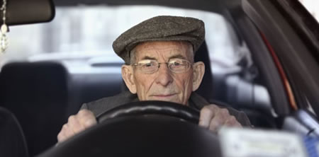
Vision
Considerable problem, GPs receive little training
“There should be rules on [visual] testing after a certain age and produce evidence to the DVLA, after 55 for instance, and have a test every three years.” (A & E Doctor)
Annual tests free for over 70s, but many people do not take a regular eye test, so would not be in a position to receive advice on their visual fitness to drive:
“… they don’t all have eye tests … because they can go to the chemist and buy some ‘ready readers’, a third of the population don’t have an eye test. I’ve got so many patients hit 70 and they’d thought they’d have an eye test because they can’t get their ‘ready readers’ strong enough to read. They are supposed to be illegal for driving but people do it.” (Optometrist).
“Police traffic officers, when they go to the scenes of the crashes and the accidents, the first thing the people say is ‘I didn’t see them, I missed that’, now you don’t know if it’s because they were half asleep at the wheel and they weren’t paying attention or whether they actually physically couldn’t see…” (Optometrist)

Slide 42
Ideas for improvement from GPs
Raise patient/public awareness
Encourage patients to take more responsibility
Computer prompts for FTD
Software to identify ‘risky’ patients
Include a question on fitness to drive to the exit examination for all relevant medical specialties
Add FTD to the Quality and Outcomes Framework in general practice

Slide 43
GP Survey
Should giving advice on FTD become part of QOF?
(200 GPs sent questionnaires, 85 responses)
62% In favour
20% Don’t know
18% No – quantity but not quality?

Slide 44
Conclusions and Recommendations
Of all HCPs, GPs are best placed to advise patients on FTD – if have a GP
Many reasons why advice is not always given
Older drivers are not inherently unsafe
Many older drivers will modify driving habits, particularly if advised to do so
Use existing software to prompt GPs to advise patients on fitness to drive
Introduce regular visual tests for drivers
Consider restricted licensing for certain medical conditions and older drivers
Need more research to test some of these ideas

